Slide 1
Introduction to Scientific Computing by
Dr. Md. Rajibul Islam
CSE, UAP

Slide 2
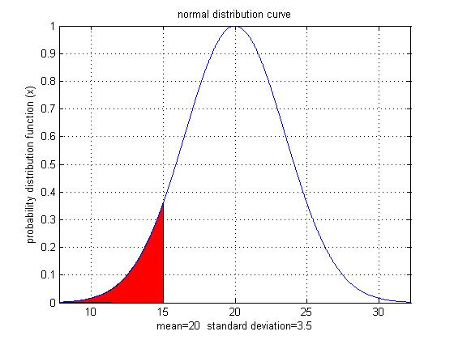
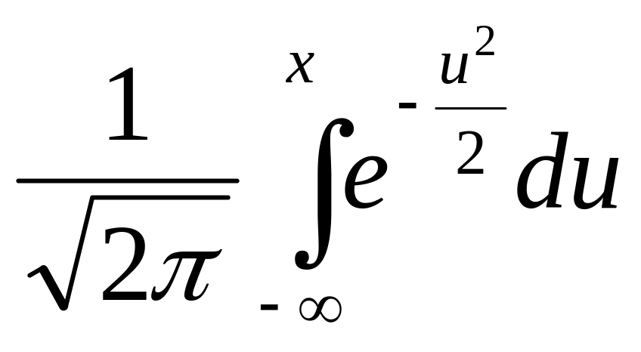
Why use Numerical Methods?
To solve problems that cannot be solved exactly

Slide 3
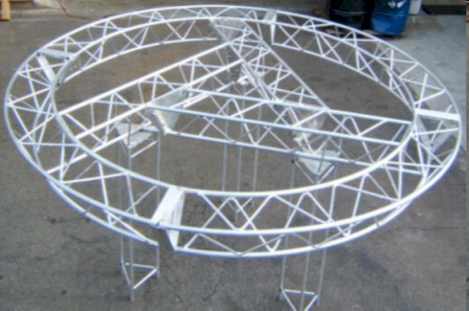
Why use Numerical Methods?
To solve problems that are intractable!

Slide 4
Steps in Solving an
Engineering Problem

Slide 5
How do we solve an engineering problem?
Problem Description
Mathematical Model
Solution of Mathematical Model
Using the Solution

Slide 6
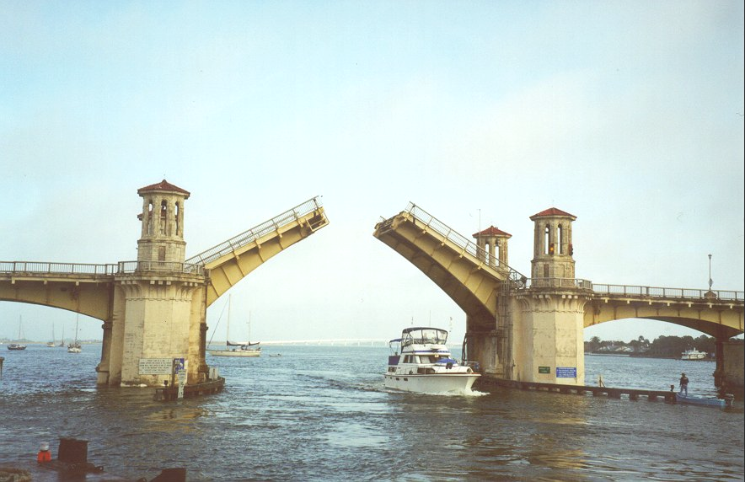
Example of Solving an Engineering Problem
Notes:
Oldest city’s oldest bascule bridge – the Bridge of Lions in St. Augustine, Florida

Slide 7
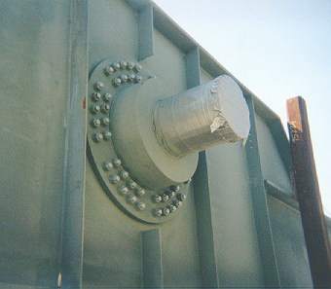
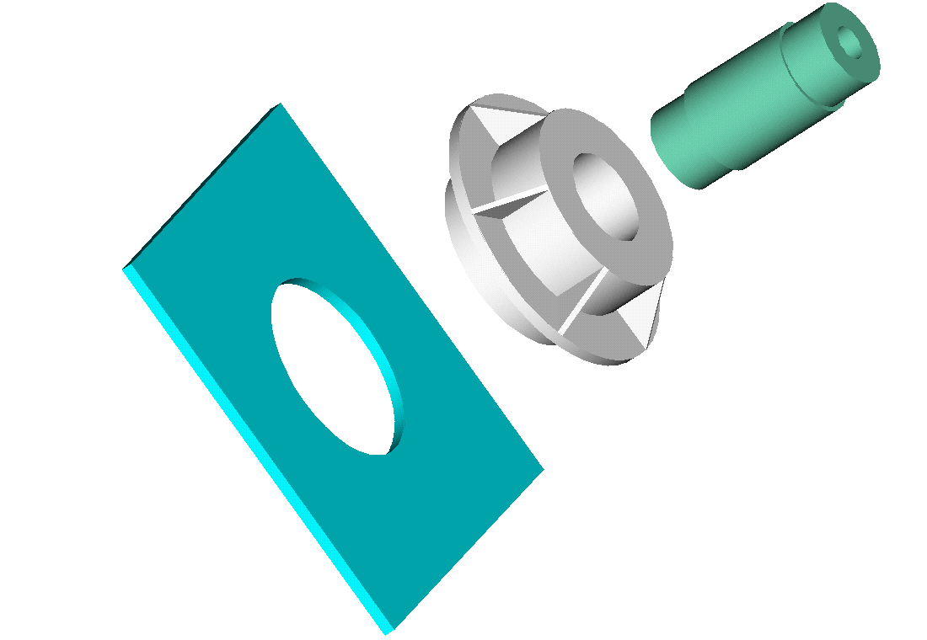
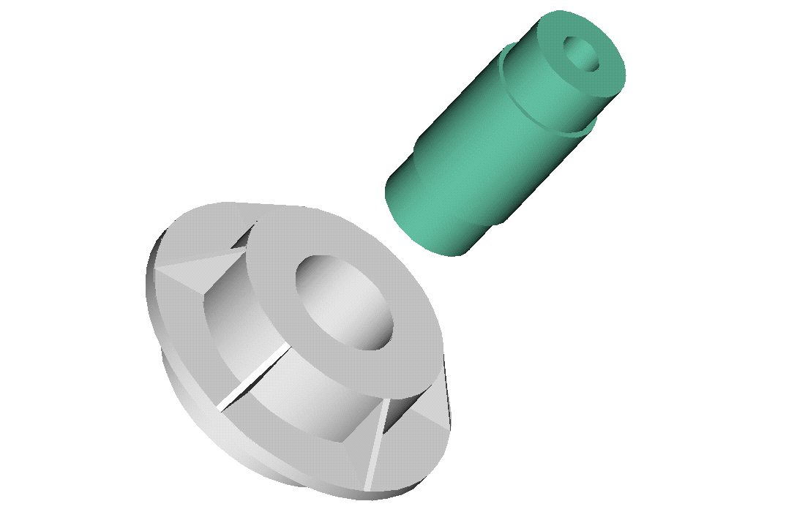
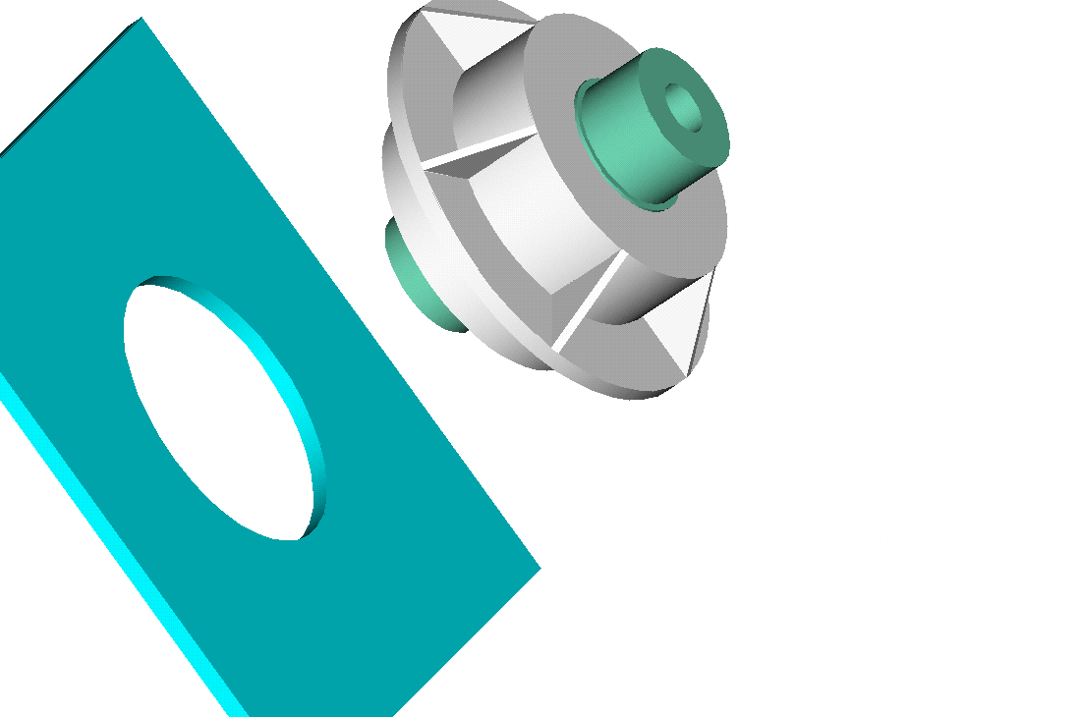
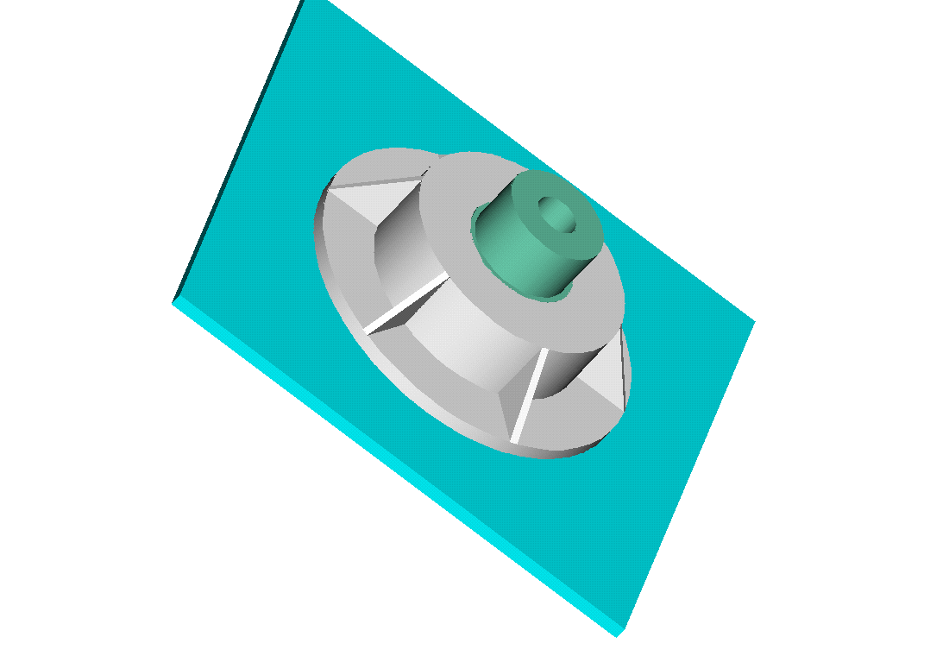
Trunnion-Hub-Girder Assembly Procedure
  Step1. Trunnion immersed in dry-ice/alcohol
  Step2. Trunnion warm-up in hub
  Step3. Trunnion-Hub immersed in
  dry-ice/alcohol
  Step4. Trunnion-Hub warm-up into girder

Slide 8
Problem
After Cooling, the Trunnion Got Stuck in Hub

Slide 9
Why did it get stuck?
Magnitude of contraction needed in the trunnion was 0.015” or more. Did it contract enough?

Slide 10
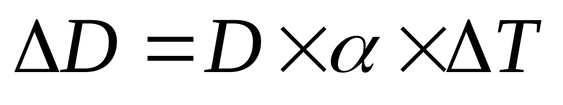
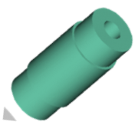
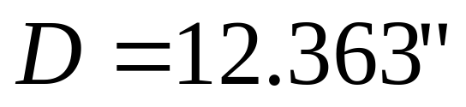
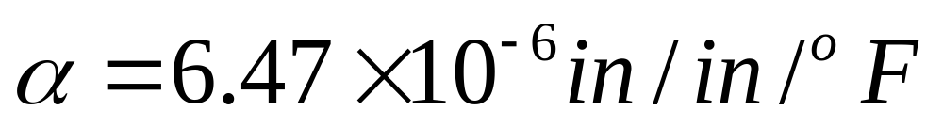
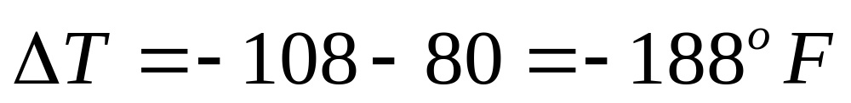
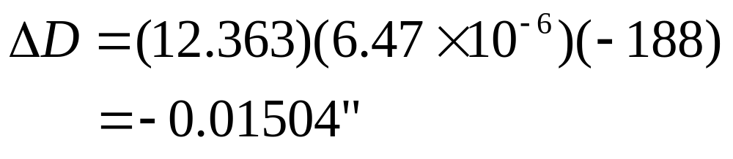
Consultant calculations

Slide 11
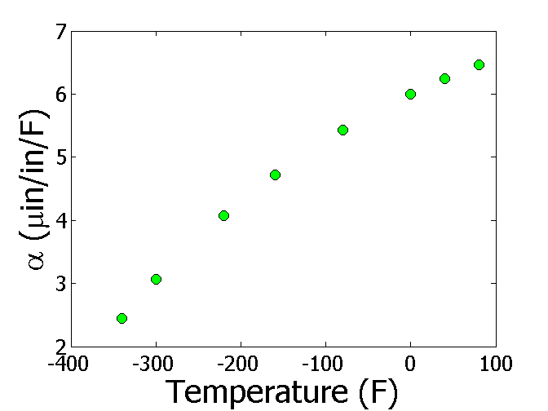

Is the formula used correct?
T(ºF) | α (μin/in/ºF)
-340 | 2.45
-300 | 3.07
-220 | 4.08
-160 | 4.72
-80 | 5.43
0 | 6.00
40 | 6.24
80 | 6.47

Slide 12
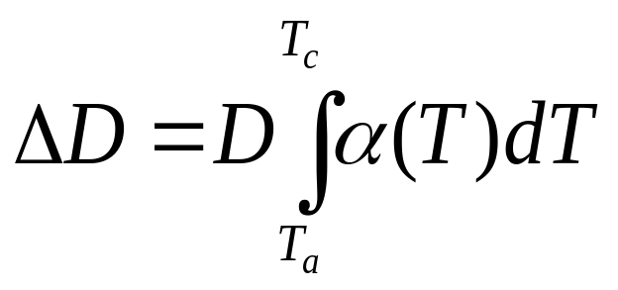
The Correct Model Would Account for Varying Thermal Expansion Coefficient

Slide 13
Can You Roughly Estimate the Contraction?
T_{a}=80ºF; T_{c}=-108ºF; D=12.363”
http://numericalmethods.eng.usf.edu

Slide 14
Can You Find a Better Estimate for the Contraction?
T_{a} = 80ºF
T_{c} = -108ºF
D = 12.363"

Slide 15
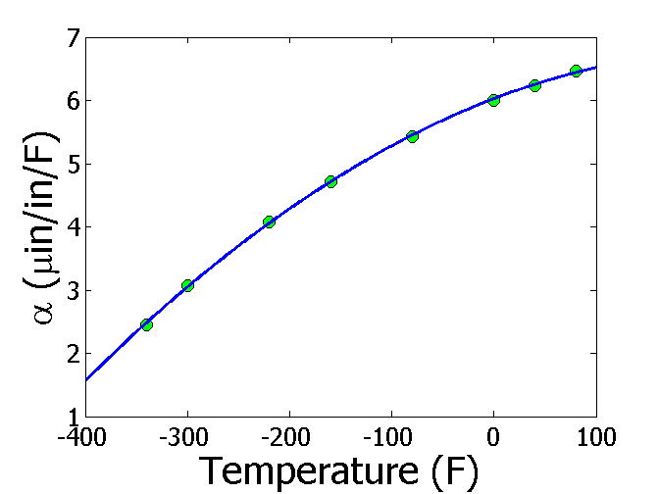
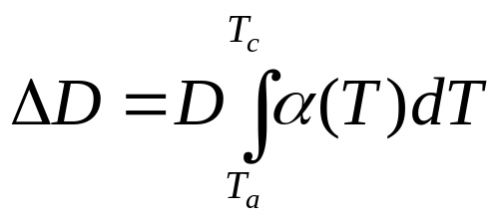
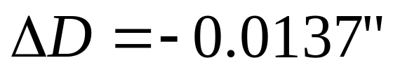
Estimating Contraction Accurately
Change in diameter (ΔD) by cooling it in dry ice/alcohol is given by
T_{a} = 80ºF
T_{c} = -108ºF
D = 12.363"

Slide 16
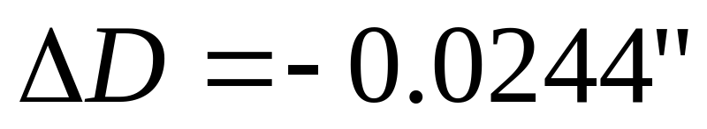
So what is the solution to the problem?
One solution is to immerse the trunnion in liquid nitrogen which has a boiling point of -321ºF as opposed to the dry-ice/alcohol temperature of -108ºF.

Slide 17
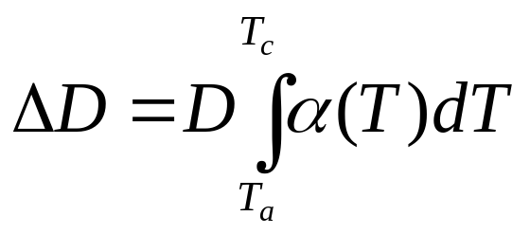
Revisiting steps to solve a problem
1) Problem Statement: Trunnion got stuck in the hub.
2) Modeling: Developed a new model
3) Solution: 1) Used trapezoidal rule OR b) Used regression and integration.
4) Implementation: Cool the trunnion in liquid nitrogen.

Slide 18
Introduction to Numerical Methods
Mathematical Procedures

Slide 19
Mathematical Procedures
Nonlinear Equations
Differentiation
Simultaneous Linear Equations
Curve Fitting
  Interpolation
  Regression
Integration
Ordinary Differential Equations
Other Advanced Mathematical Procedures:
  Partial Differential Equations
  Optimization
  Fast Fourier Transforms

Slide 20

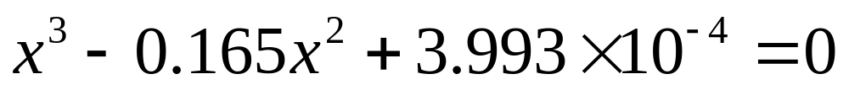
Nonlinear Equations
How much of the floating ball is under water?
Buoyancy force
Diameter=0.11m
Specific Gravity=0.6
Weight of the ball

Slide 21
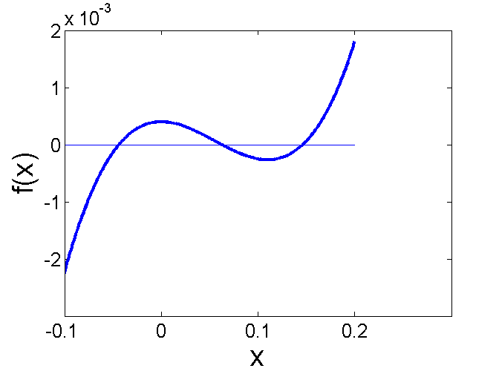
Nonlinear Equations
How much of the floating ball is under the water?
Diameter=0.11m
Specific Gravity=0.6

Slide 22
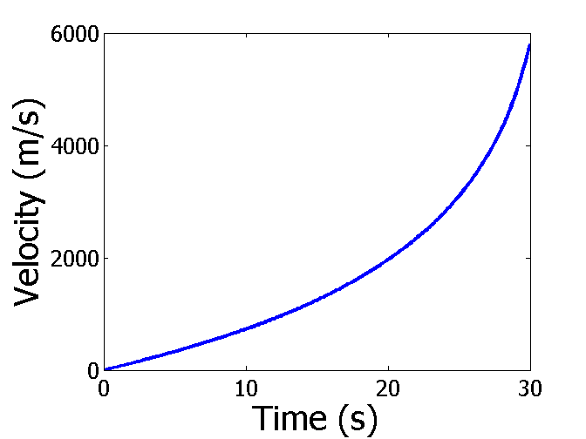

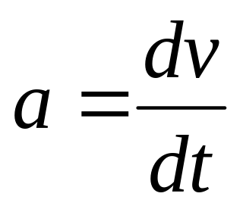
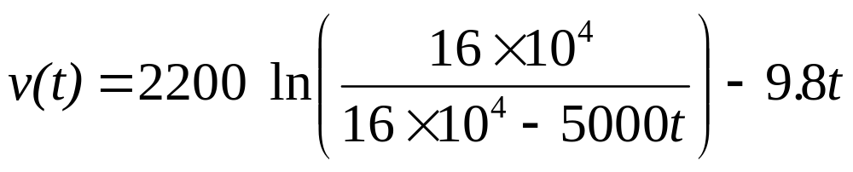
Differentiation
What is the acceleration at t=7 seconds?

Slide 23
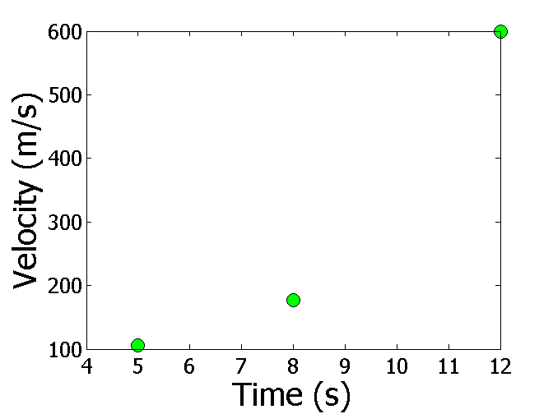
Differentiation
What is the acceleration at t=7 seconds?
Time (s) | 5 | 8 | 12
Vel (m/s) | 106 | 177 | 600

Slide 24
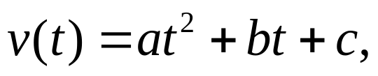

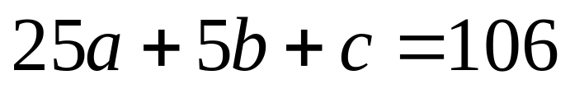
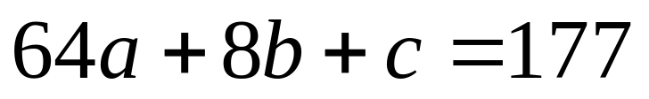
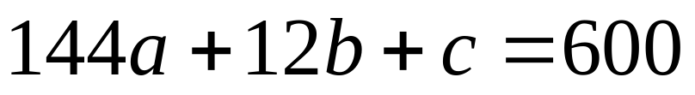
Simultaneous Linear Equations
Find the velocity profile, given
Time (s) | 5 | 8 | 12
Vel (m/s) | 106 | 177 | 600
Three simultaneous linear equations

Slide 25
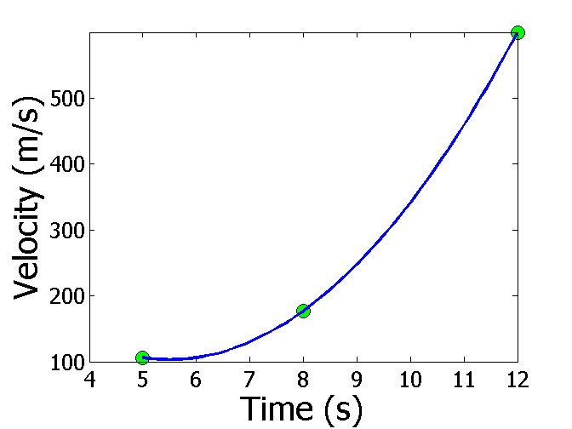
Interpolation
What is the velocity of the rocket at t=7 seconds?
Time (s) | 5 | 8 | 12
Vel (m/s) | 106 | 177 | 600

Slide 26
Regression
Thermal expansion coefficient data for cast steel

Slide 27
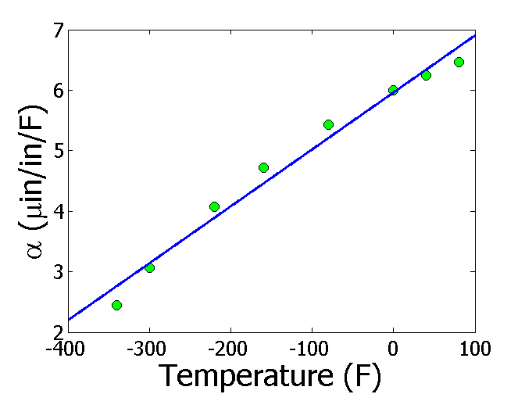
Regression (cont)

Slide 28
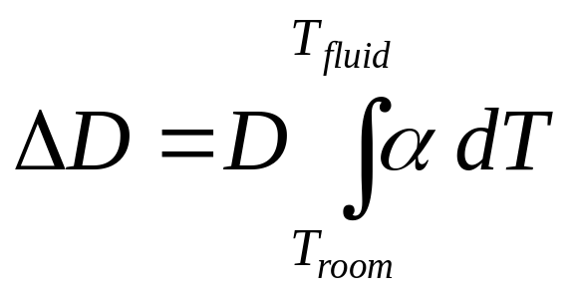
Integration
Finding the diametric contraction in a steel shaft when dipped in liquid nitrogen.
Add all trapezoids

Slide 29
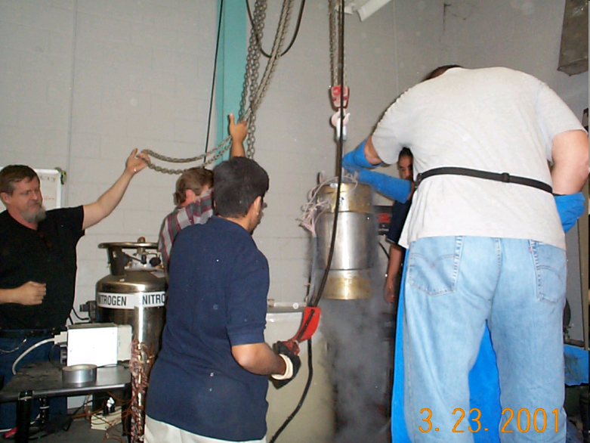
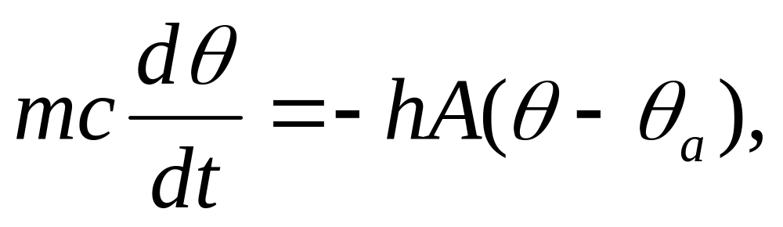
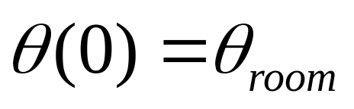
Ordinary Differential Equations
How long does it take a trunnion to cool down?
Temp Vs Time
temperature
Cross section of the liquid and trunnion
Mass
Convection coefficient of liquid (not constant)
Initial condition
Specific heat
Ambient temperature

Slide 30
Additional Resources
Numerical Methods with Applications: Abridged (2nd Edition) – Autar Kaw, Egwu Kalu
  http://mathforcollege.com/nm/topics/textbook_index.html
Introductory Methods of Numerocal Analysis – S. S. Sastry

Slide 31
THE END

